Slide 1
Schedules 1
Team members:
Martin Mayembe
Vladyslav
Valentyn
Yash Mange
Iker

Slide 2
Introduction
Focused on Schedules part of the system
Repository: https://github.com/mayembe-martin/software_architecture_schedules

Slide 3
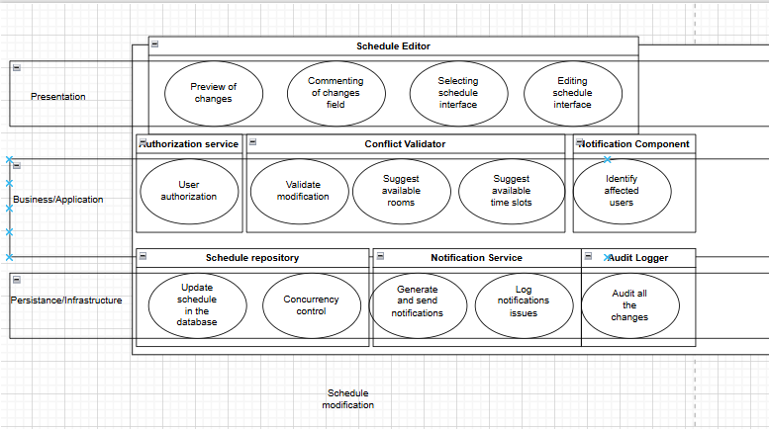

Slide 4
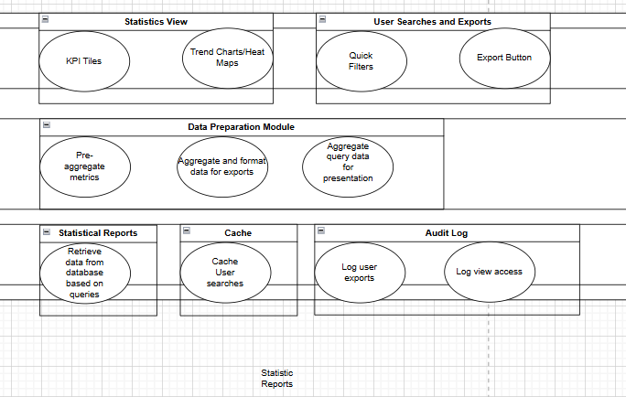

Slide 5
Core Features
Viewing the timetable (Valentyn)
Viewing the course info (Yash)
Viewing the teacher info – office hours (Iker)
Schedule modification (Vlad)
Statistical reports (Martin)

Slide 6
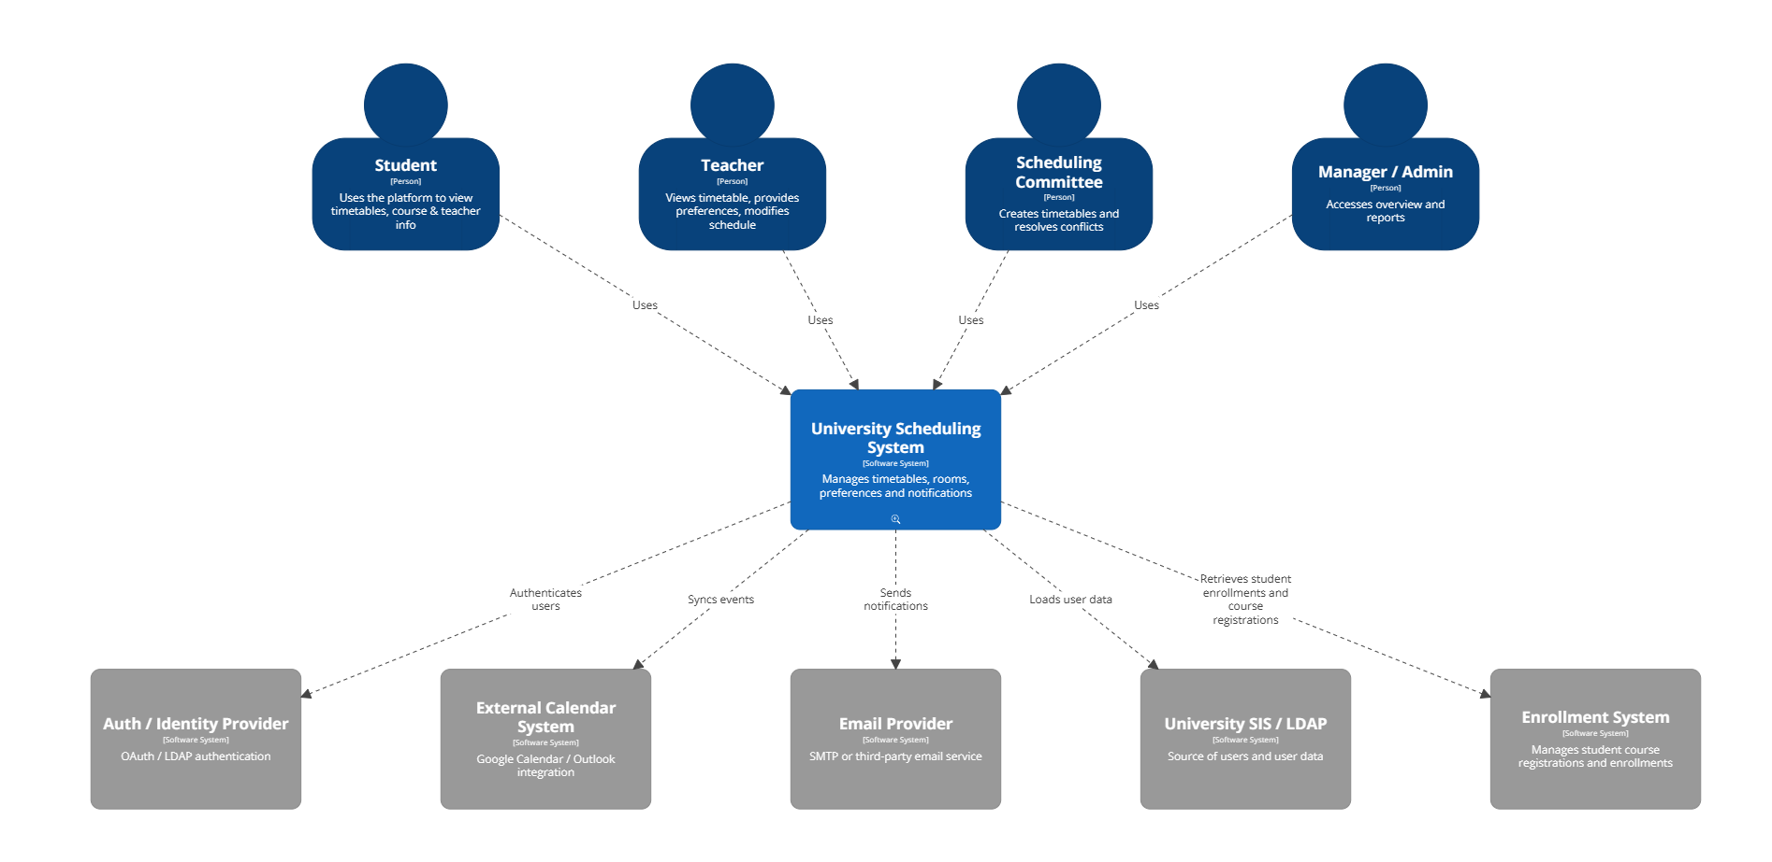
C4 model L1 :

Slide 7
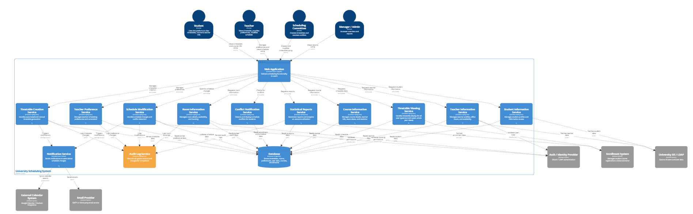
C4 Model L2:

Slide 8
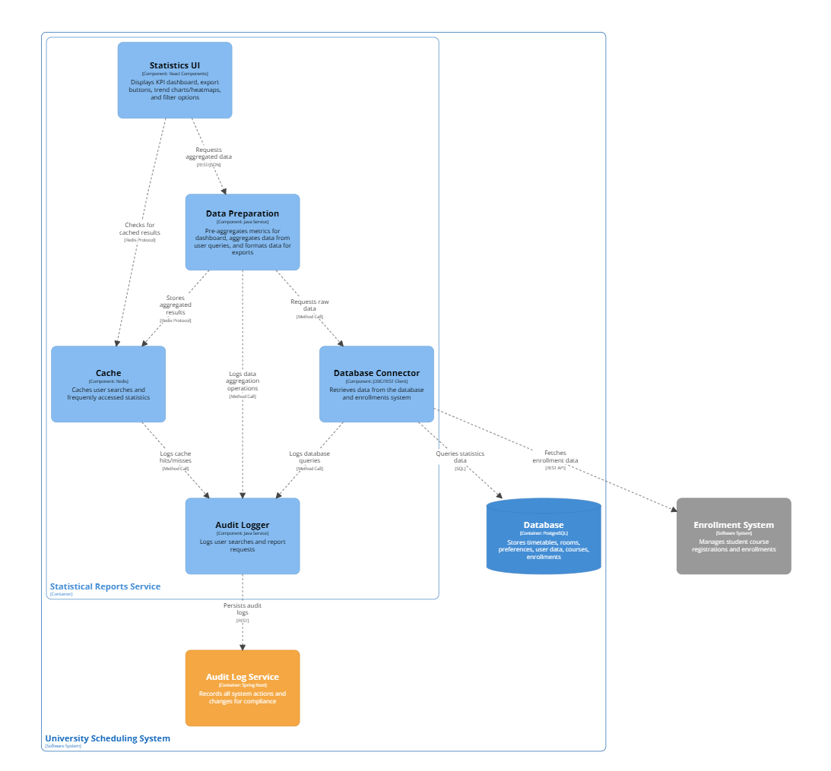
Statistics L3

Slide 9
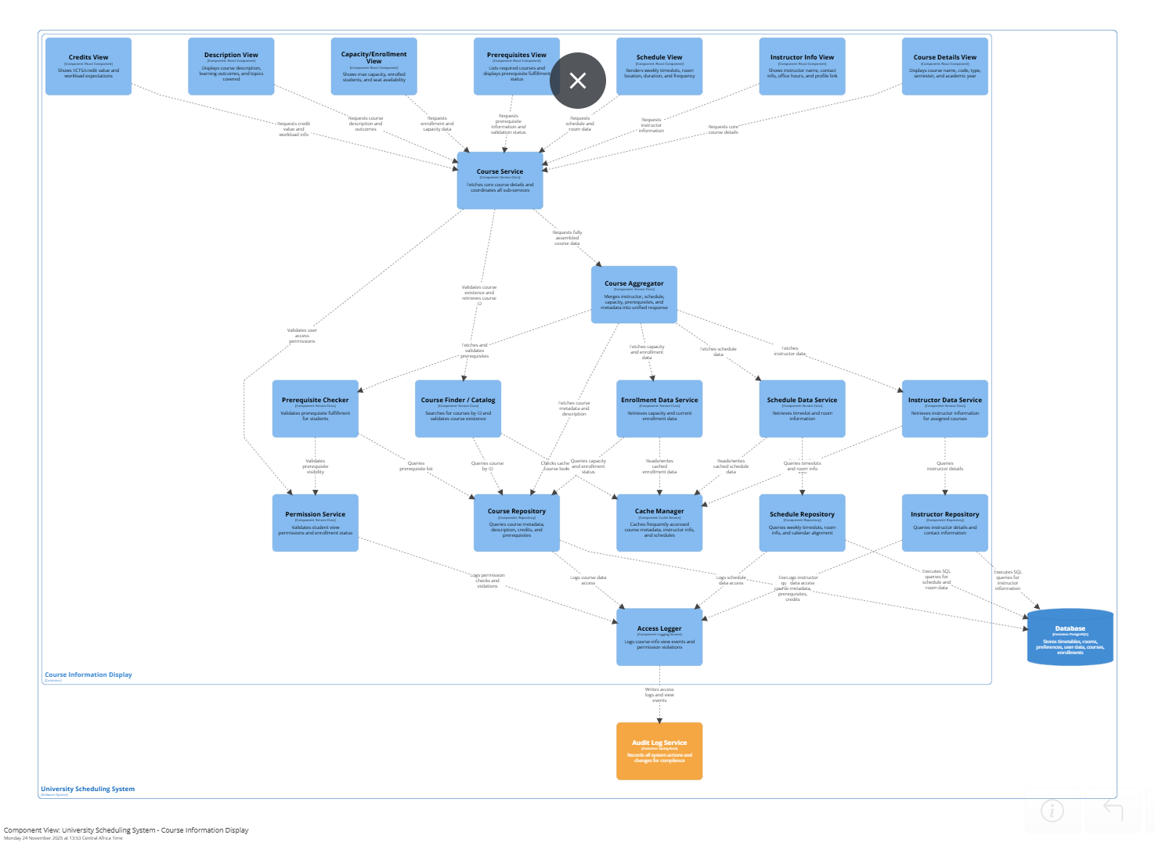
Course Info L3

Slide 10
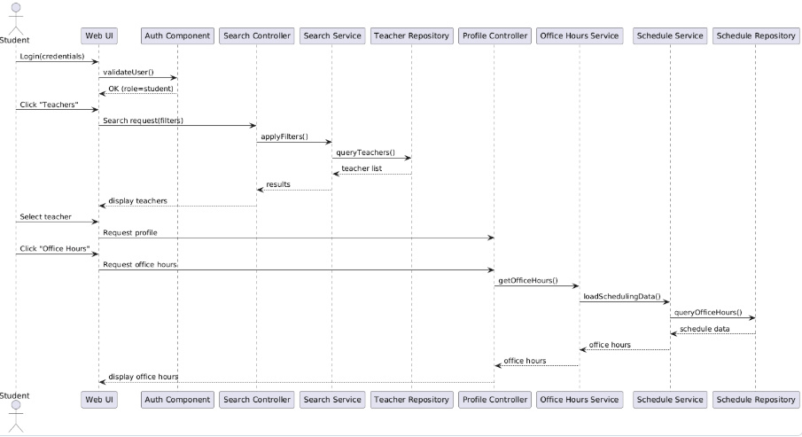
Office hours

Slide 11
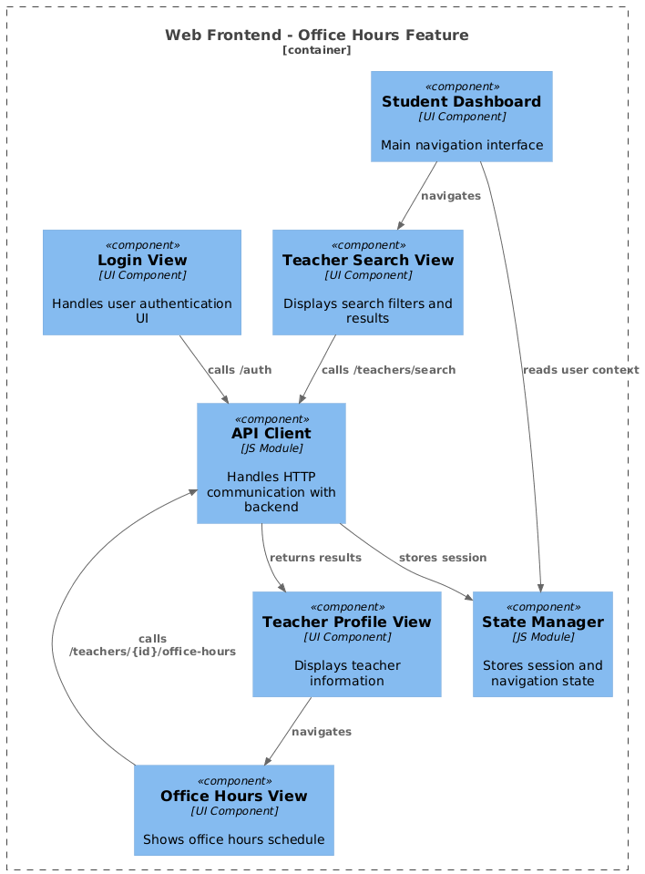
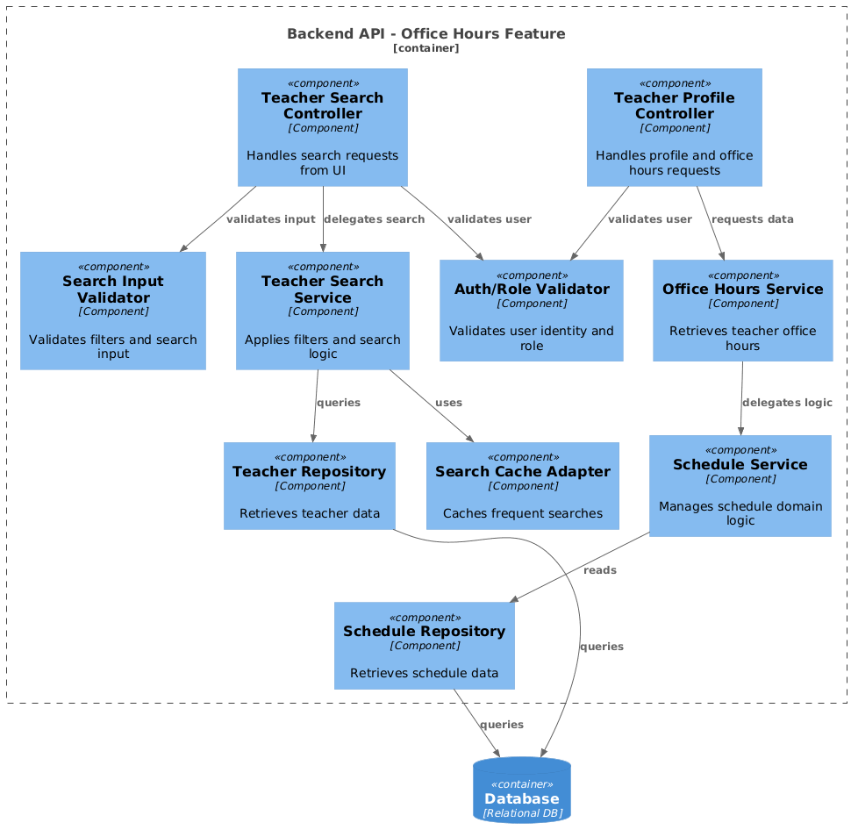

Slide 12
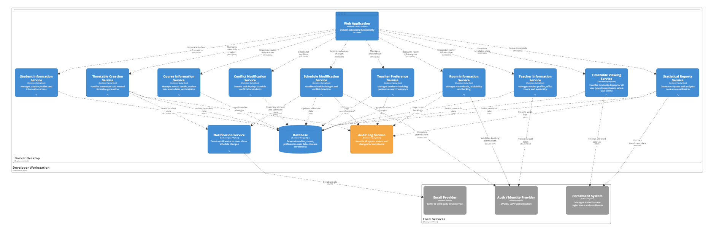
Deployment diagram

Slide 13
Thank you

